Slide 1
Smart Health
Team : The Mavericks

Slide 2
PROGRESS
Created IONIC Application contains Following Pages :
Login page with all validations
Register page with all validations
Home page uses Four Square API

Slide 3
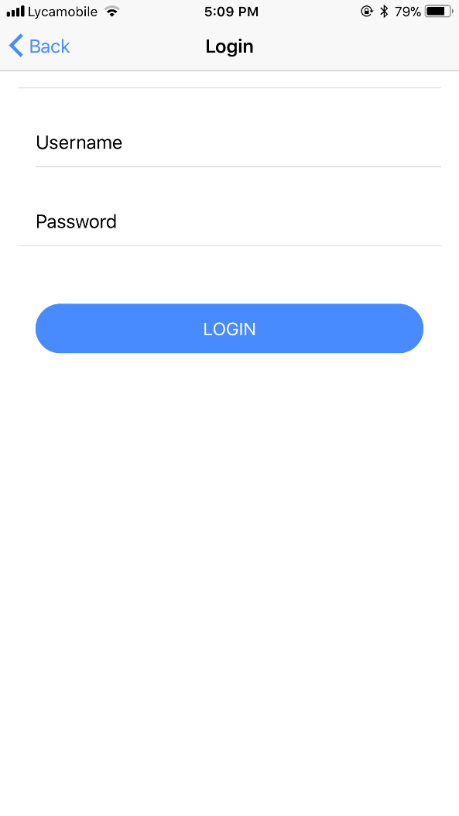
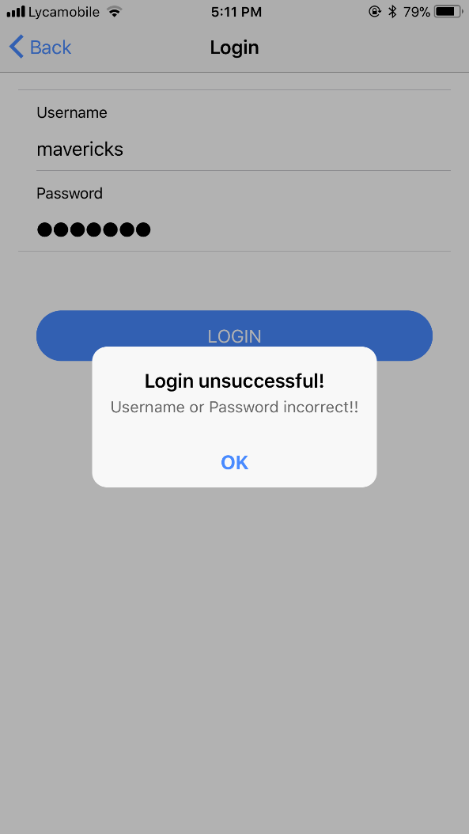
LOGIN PAGES
Validates user

Slide 4
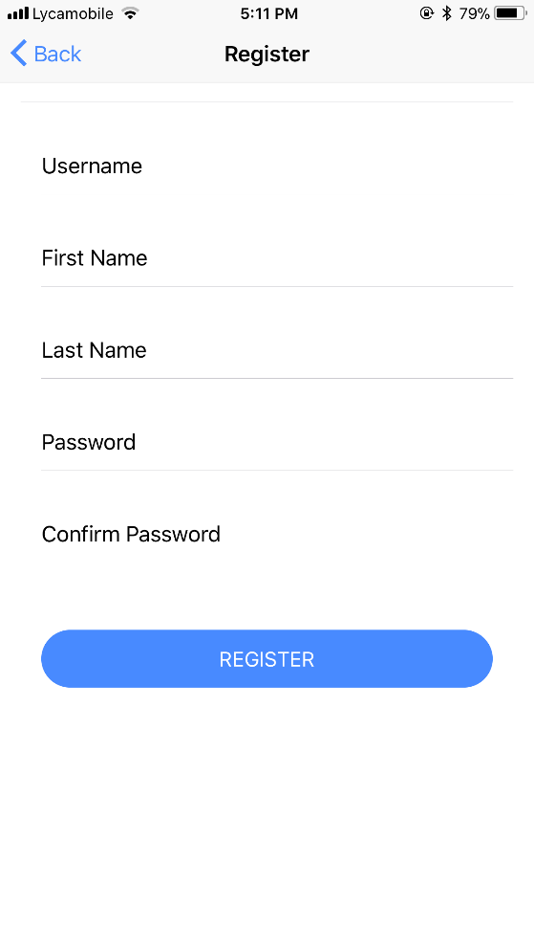
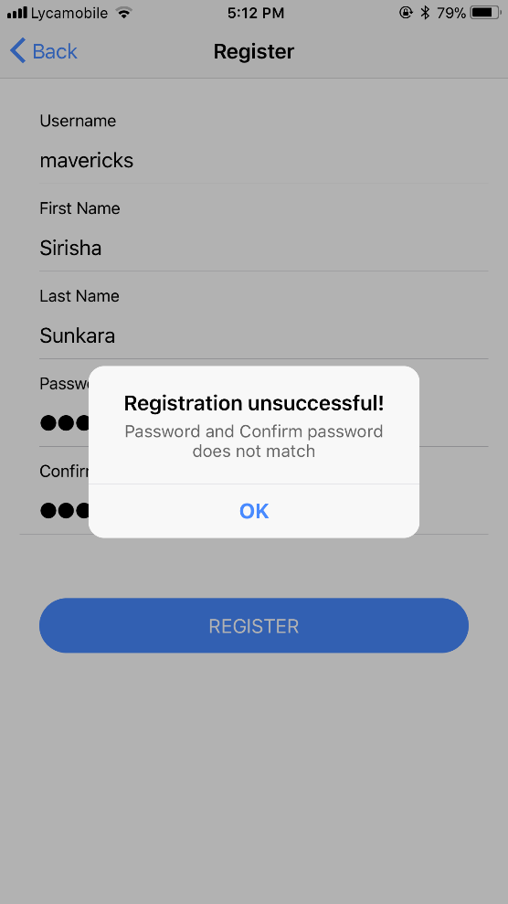
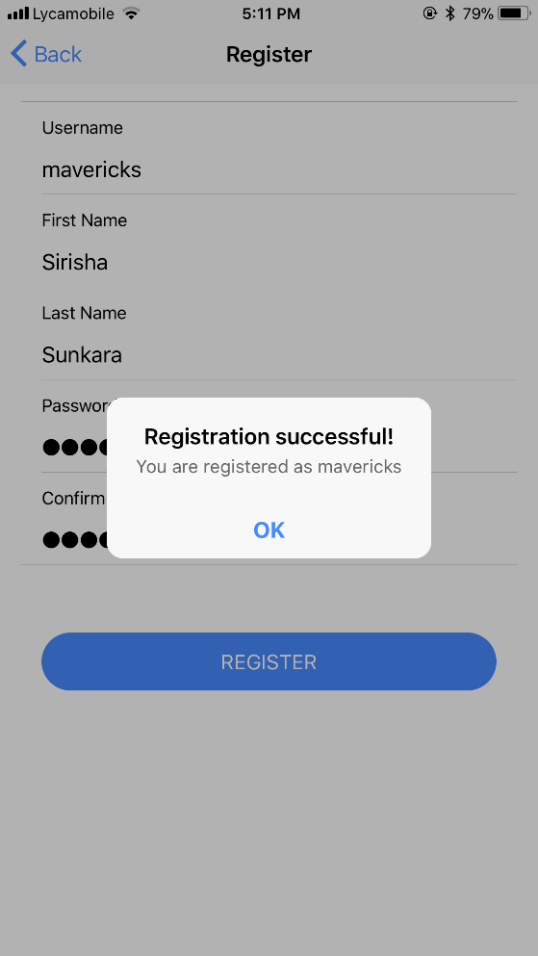
REGISTER PAGE
Register page with validations
It will consider credentials only when password and confirm password are same

Slide 5
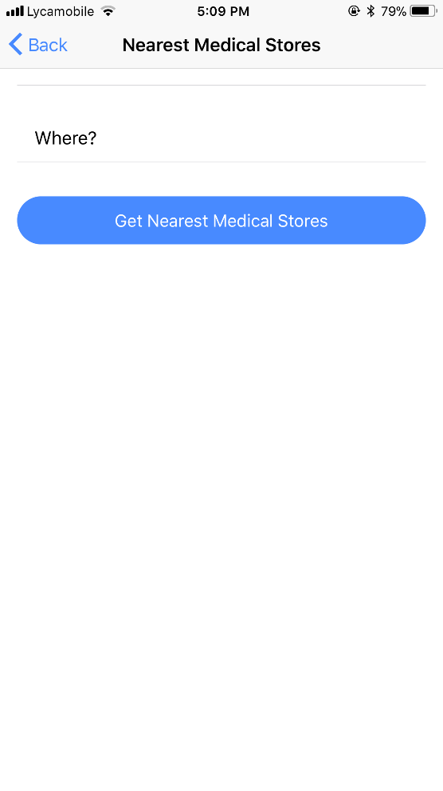
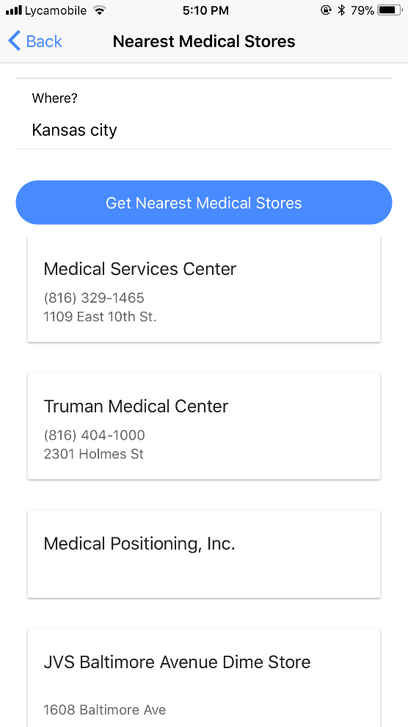
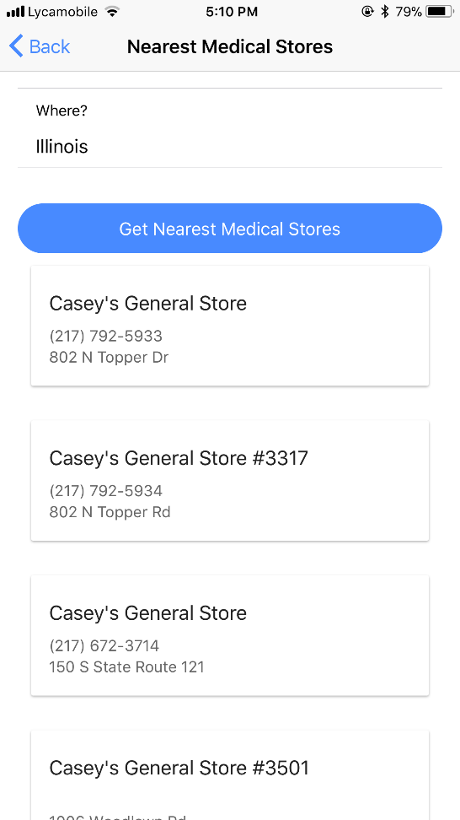
FOUR SQUARE API
Retrieve data of the nearest medical stores with their address and phone numbers

